Slide 1

News Application Using Alan AI
by
B.Devendra
Roll No. 184G1A0513
S.Momeena
Roll No. 184G1A0548
Manish Ranjan
Roll No. 184G1A0543
G.Hemasree
Roll No. 184G1A0523
Under the guidance of
Mr. C.Sudheer Kumar M.Tech.,(Ph.D).
Assistant Professor
GitHub Link: https://github.com/mandivson/Alan-News-Application
Department of Computer Science and Engineering
Srinivasa Ramanujan Institute of Technology
(Affiliated to JNTUA & Approved by AICTE) (Accredited by NAAC with ‘A’ Grade & Accredited by NBA (EEE, ECE & CSE)
Rotarypuram Village, B K Samudram Mandal, Ananthapuramu – 515701.
2021 - 2022

Slide 2
Abstract
News websites are sites developed to deliver the headlines in a different format than television, print or radio. These sites include articles that have a large variety of information which consists of international, national, entertainment, games, sports, education or other miscellaneous information.
Reading newspapers takes up a lot of time and the reader usually spends reading about articles in which they are not interested. By using this project, the user can get to hear about all the important headlines of their chosen topic on the go, in just few minutes. This application brings in the latest headlines and the user can use the voice control feature to fetch categorical news, news with specific terms and news from different sources by interacting with the application.

Slide 3
Contents
Introduction
Literature Survey
Existing System
Proposed System
Problem Definition
Requirements
Architecture
UML Diagrams
Structure of the Project
Implementation
Sample Code
Screenshots
Conclusion
References

Slide 4
Introduction
Traditional news gathering methods such as newspapers,televisions have been and suceeded for a long time.In modern day, we are familiar with the use of smartphones.With rapid advancements in computing technology,we have achieved steps closer to developing AI.
This project is an effort to make news reading more fun and interactive using the ALAN voice assistant.
The interaction of voice assistants in news applications will not only enhance the user experience but also make news make more engaging in the near future.

Slide 5
Literature Survey
[Sameer Mahajan, Nahush Kulkarni - 1] :The paper focuses on presenting information in an easy and intelligible manner which provides the information on fetching the data from the rest API and displaying it on to the front end of the application. The paper also focuses upon the usage of Alan studio on the backend of the application. The integration of the front end and back end of the application is also well described with the help of flow chart and diagrams.
[Aaditya Chaprana, Ranjeet Kumar, Ajay Saini, Akash Kumar - 2] :The paper discusses the working diagram of the system and some research on Google trend report for the term “Breaking News”. The paper also describes the architecture of the web application and the implementation of the Alan studio. It also focuses on the taxonomy of the speech recognition systems, design implementation and the scope of the web application.

Slide 6
Existing System
Reading newspaper takes up a lot of time and the reader usually spends reading about articles in which they are not interested.
Newspapers can only give information on the basis of what is important according to them.
User has to browse by texting for interesting head lines, which takes time and they have to wait for their article to display.
User has to scroll while reading and ads are displayed either on the top or bottom of the screen.
Not easy to read for long due to eye strain.
The existing systems like Alexa are not suitable to be carried anywhere and do not display the news to the users.

Slide 7
Proposed System
To overcome the difficulty of existing system, we develop a web application which fetches global news from various sources and displays it to the user.
In this project, we have also used Alan AI with which, information can be gathered by users with the use of voice commands.
When a user asks Alan about a topic, the AI synthesizes their speech into commands that can then be used to gather categorical news, news with specific terms and from different sources by interacting with the application.

Slide 8
Problem Definition
The existing system which consists of traditional methods of data entry fail the requirements to support all type of users.
The hands-free approach provided by the system goes to a great length and makes the user interact more often as the user usually prefers to use voice commands rather than giving commands by typing.
The biggest advantage of the proposed system is that the voice recognition is not limited to just mobile phones, laptops or computers and it also provides a user friendly experience which helps user save time as well as physical work.

Slide 9
Requirements :
Hardware Requirements:
Intel (R) Core(TM) i3 1.99 GHZ processor or above
Minimum 4GB of RAM
Band width greater than 50 kbps and latency under 150 ms
Software Requirements:
OS: Windows 7 or above Operating System
IDE : Visual Studio Code
Libraries : React Js, Material UI
Back end run time environment : Node.js
Package Manager : NPM (Node Package Manager)
Voice AI platform : Alan AI
Latest browser requirements and android in mobile

Slide 10
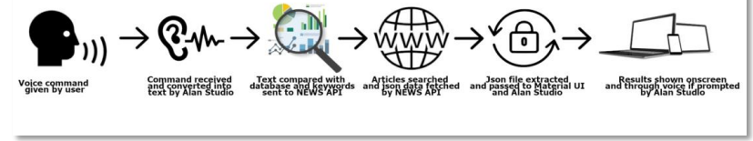
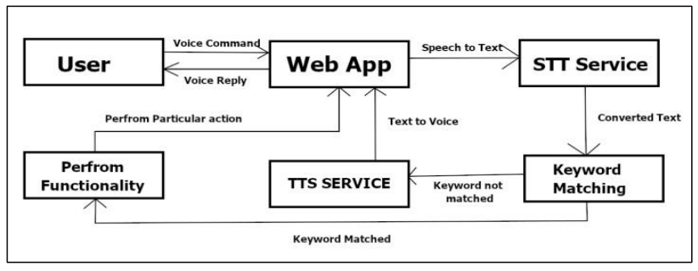
Architecture
Working Diagram of the System
Architecture of Web Application

Slide 11
Use Case Diagram
Access the website
Updating Commands
Voice commands to Alan
User
Control on Log
Developer
Command for display, search, read news
Write Voice Commands Manually
Commands for various categories of news
Control the Website

Slide 12
Activity Diagram
Access the website
Input Voice Command
Speech To Text Service
Text To Speech Service
Keyword Matching ?
No
Yes
Show Results

Slide 13
Deployment Diagram
News API
User
Web App
Alan API
Alan Studio

Slide 14
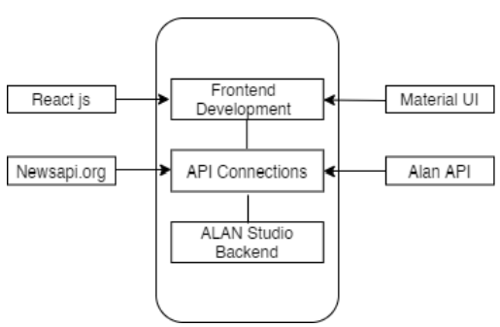
Structure of the Project
Overall Structure

Slide 15
Implementation
Alan studio offers the voice recognition and delivery capabilities and analyses the vocal instructions provided by the user and identifies the keywords and the task that the user has asked.
The selected keywords are passed through to the NEWS API that searches for the news articles about the selected keyword and returns the json file containing all the textual data that the articles contain.
The Material UI helps to extract the data from the json file and it passes the extracted data to the Alan studio which once again reads and analyses the data and converts into voice and reads the articles to the user.
The step by step execution of the proposed system is as shown:

Slide 16
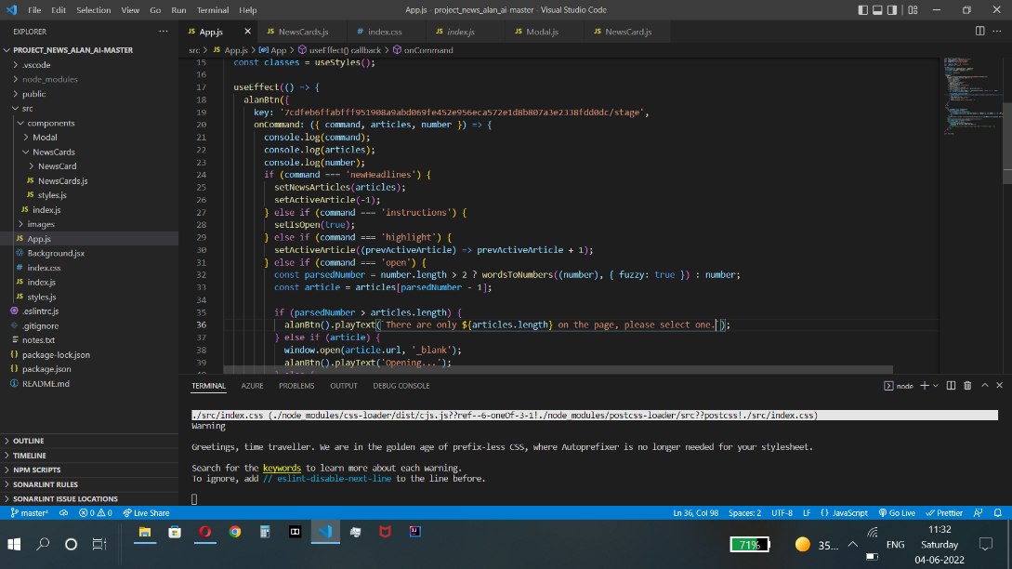
Sample Code
Front end visual studio code.

Slide 17
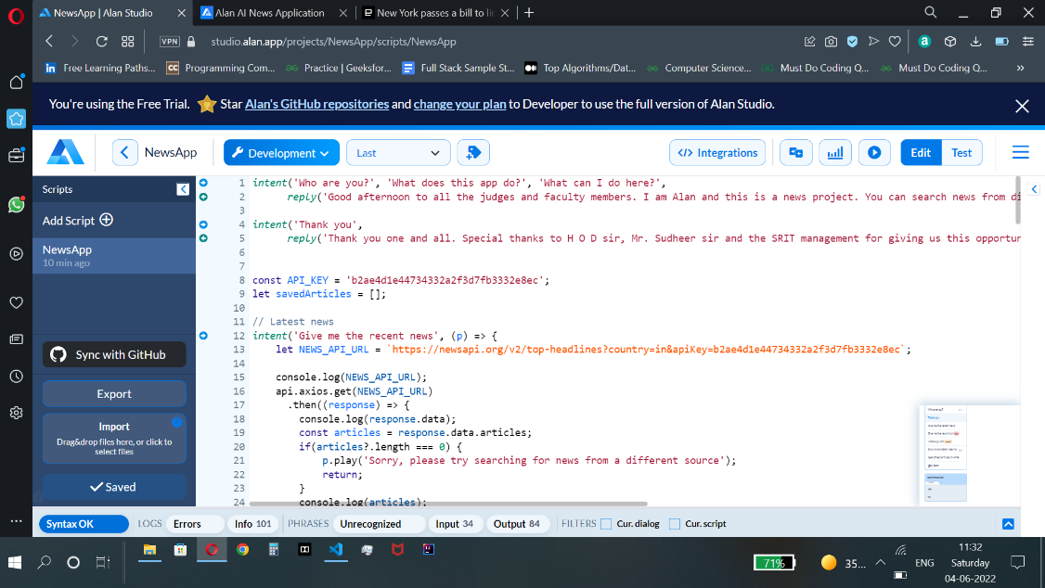
Contd…
Alan studio code.

Slide 18
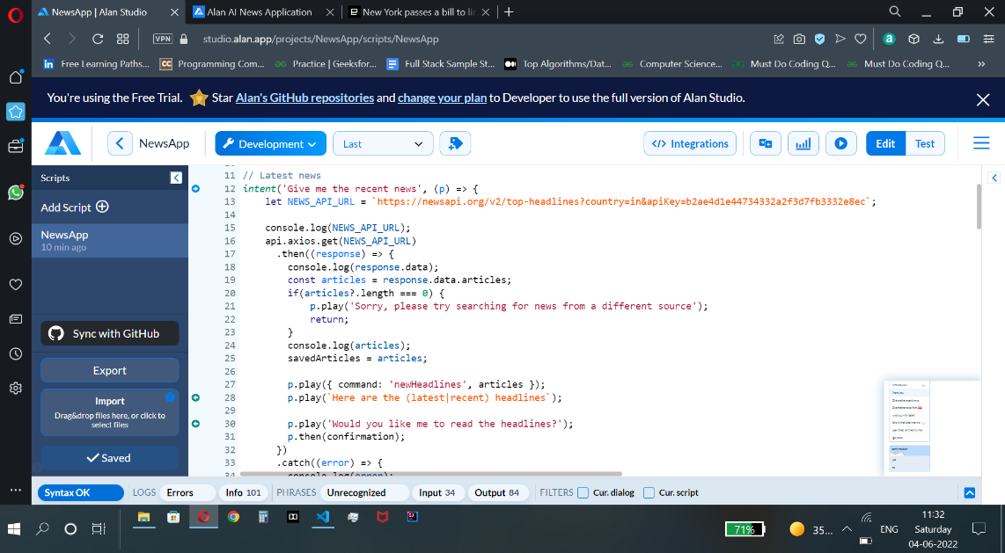
Contd…
Code for recent headlines.

Slide 19
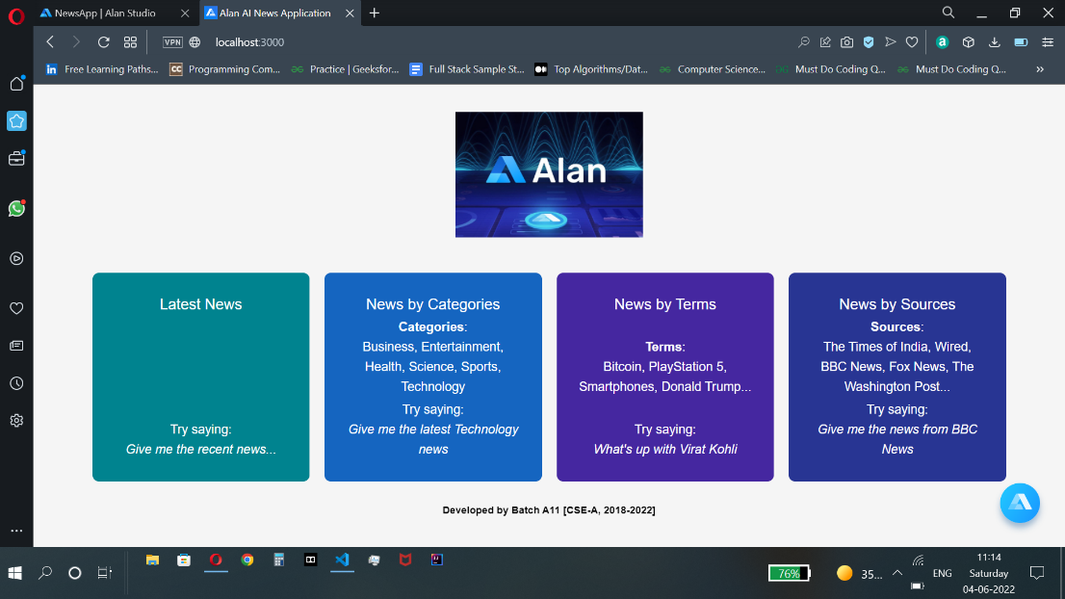
Screenshots
Home Screen

Slide 20
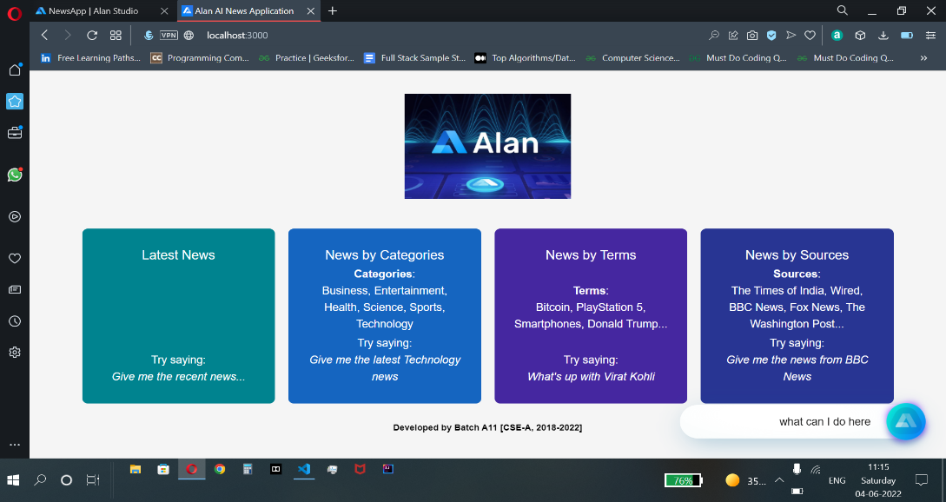
Contd…
Giving initial command to the voice assistant.

Slide 21

Contd…
Command for fetching recent headlines.

Slide 22
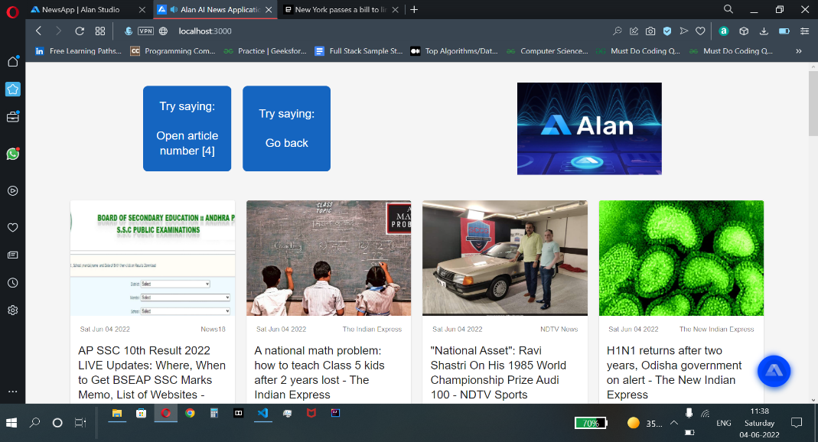
Contd…
Output:

Slide 23

Contd…
Command for fetching latest category news.

Slide 24
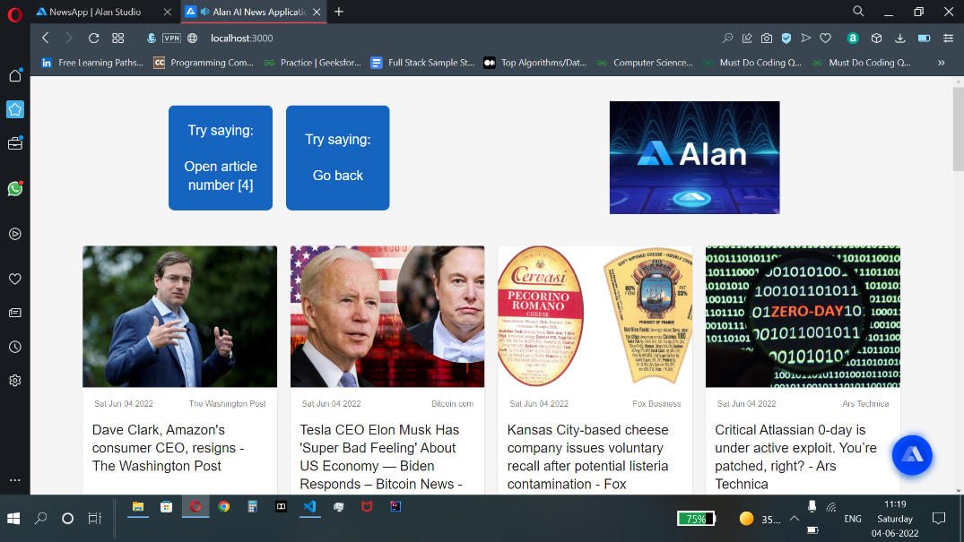
Contd…
Output:

Slide 25

Contd…
Command for fetching news by terms.

Slide 26
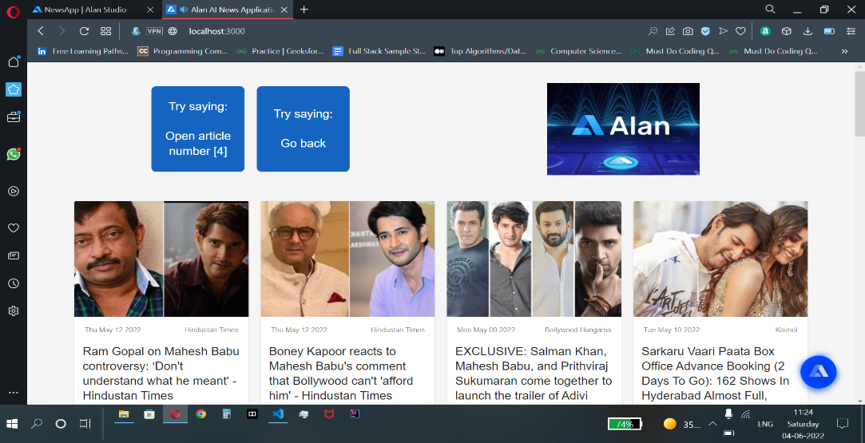
Contd…
Output:

Slide 27

Contd…
Command for fetching news from source.

Slide 28
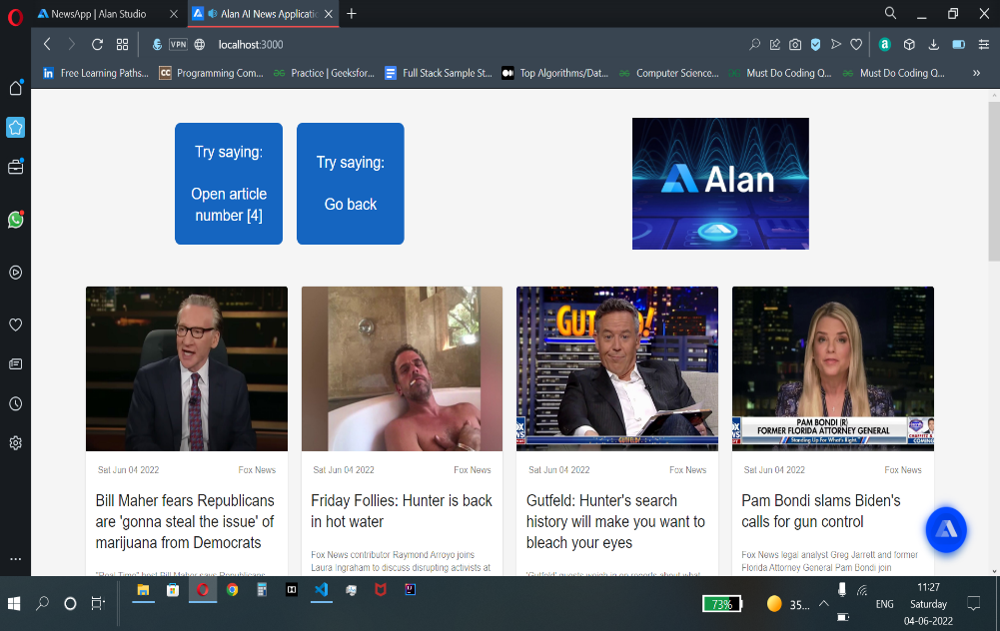
Contd…
Output:

Slide 29
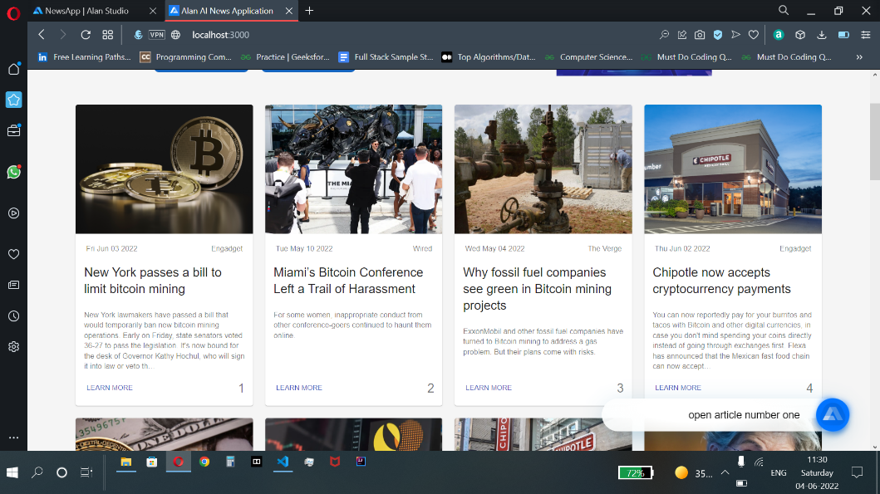
Contd…
Command for opening an article using number.

Slide 30
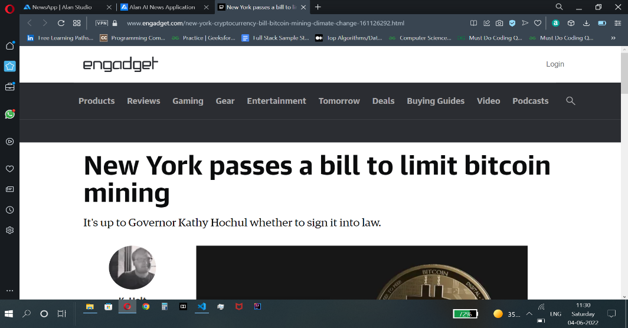
Contd…
Output:

Slide 31
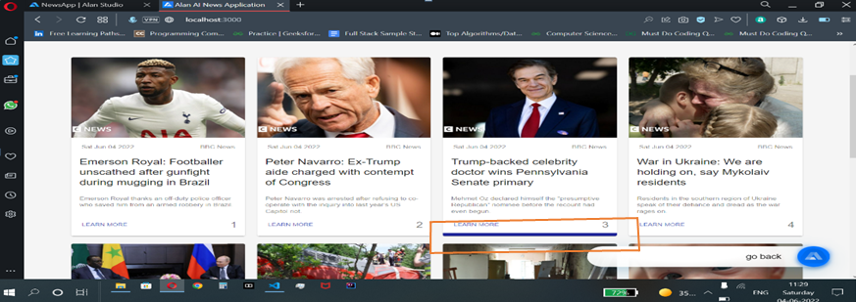
Contd…
Command for going back.
Blue colour bar highlight the article when voice assistant reads it.

Slide 32
Conclusion
The Proposed system enables a wide range of users to stay informed and updates while using as less time as possible. It makes getting informed and knowledgeable easy and very interesting. People with limited time now can easily get up to date just with the help of a few vocal commands. It also helps physically challenged people to make use of the latest advancements in the technical fields and enables them to stay updated and informed without their health condition hampering them. The system also enables user to listen to the articles that grab our interests and those that it thinks that are important for the user to know.
The system will continue to develop and more and more functionalities cam be added to it. The number of efforts going into the development of voice recognition and voice command adding with the continuously increasing demand of the users, the system will never get outdated. The system is flexible, user interactive and compatible to almost every device that has the ability of voice command.

Slide 33
References
[1]. Sameer Mahajan, Nahush Kulkarni, “A Conversational News Application Project using Artificial Intelligence based Voice Assistance”,” International Research Journal of Engineering and Technology (IRJET) , vol. 7, pp. 3779-3782, Sep. 2020.
[2]. Aaditya Chaprana, Ranjeet Kumar, Ajay Saini, Akash Kumar, “Voice Controlled News Web Application with Speech Recognition using Alan Studio”,” International Journal of Computer Applications (0975 – 8887) Volume 183, pp. 31-37, May 2021.

Slide 34
Thank You!!!

